Slide 1
Lecture 2 – Inputs
this lecture will introduce how to input signals into an Arduino.

Slide 2
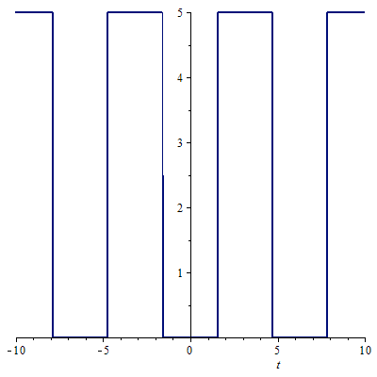
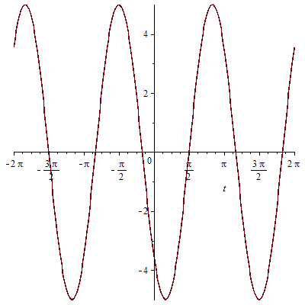
Signal Types
Digital Analogue

Slide 3

Digital Signals
Only two possible values
Information is transmitted by a series of HIGHs and LOWs
In the case of an Arduino its 5V and 0V
Beware! That not all devices use 5v

Slide 4
Analogue Signals (The proper spelling)
Can have ANY value
Information can be transmitted by the amplitude as well as the order of the signal
The Arduino can read an analogue signal but it cannot output true analogue (more on that in a bit)

Slide 5
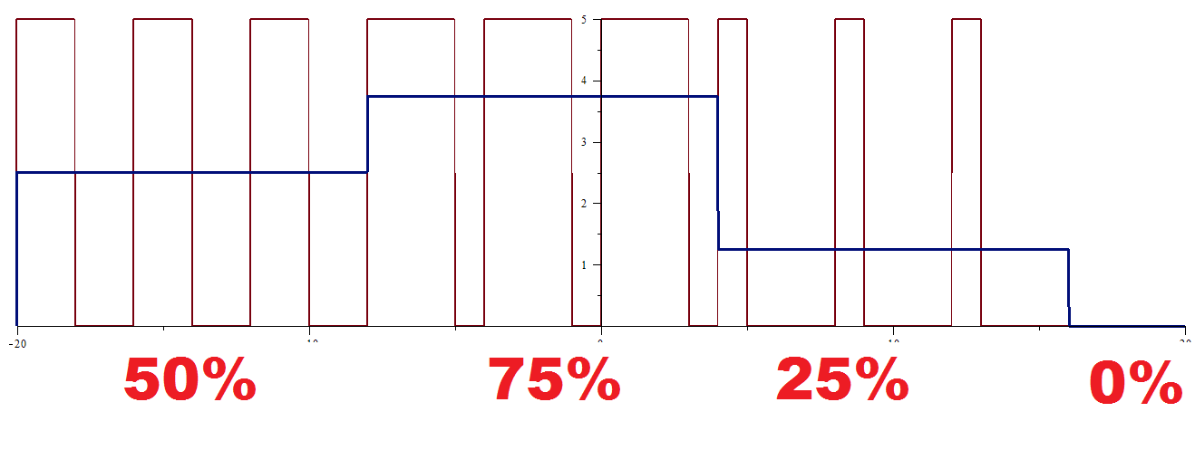
PWM – Pulse Width Modulation
Notes:
Time between ALL pulses is the same
Time on changes
Blue line = average

Slide 6

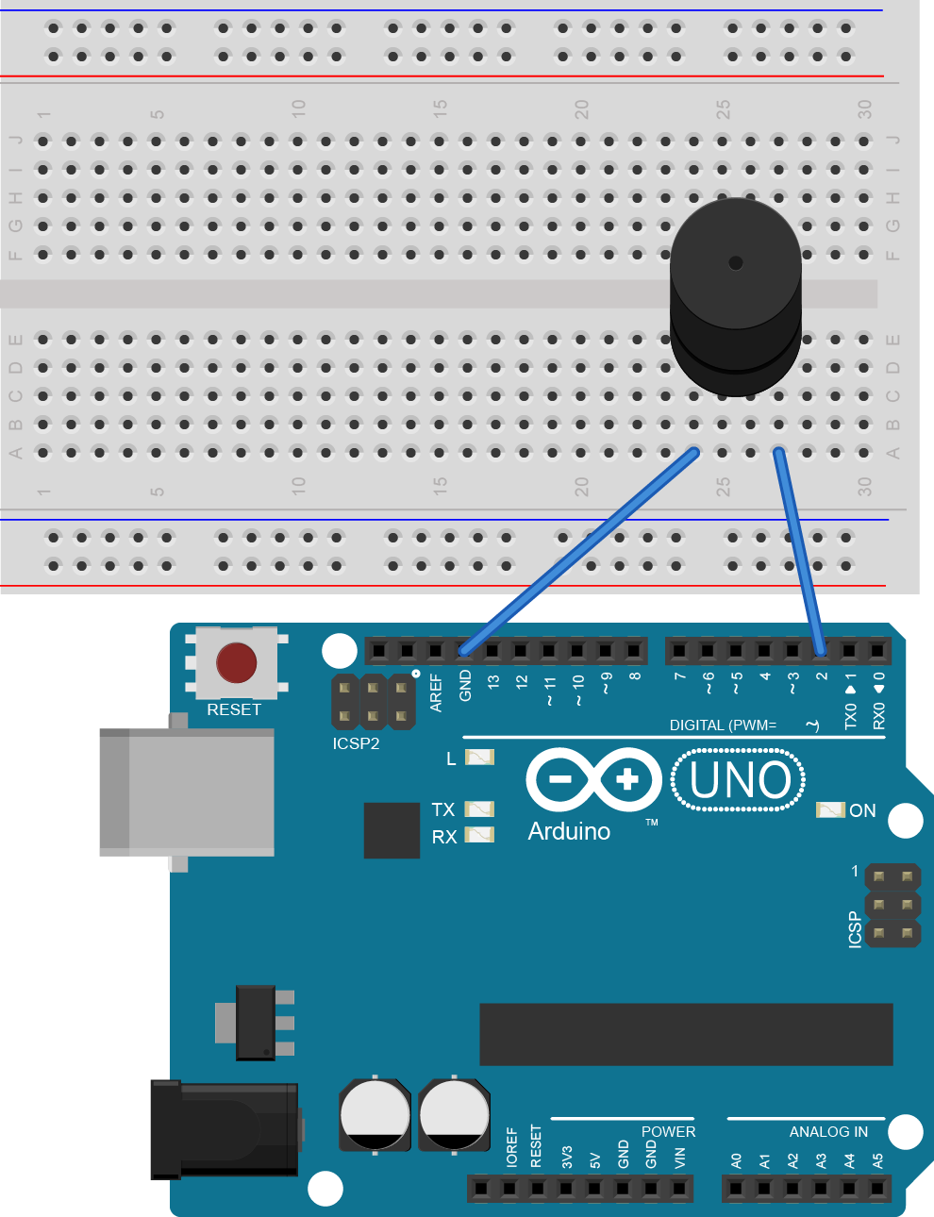
Buzzer – Back with a vengeance
void setup()
{
//Nothing to see here, move along
}
int toneDuration = 3; //In milliseconds
int buzzerPin = 2
void loop()
{
for (int freq = 400; freq<1500; freq+=10) {
tone(buzzerPin, freq);
delay(toneDuration*1.3);
noTone(buzzerPin);
}
}

Slide 7
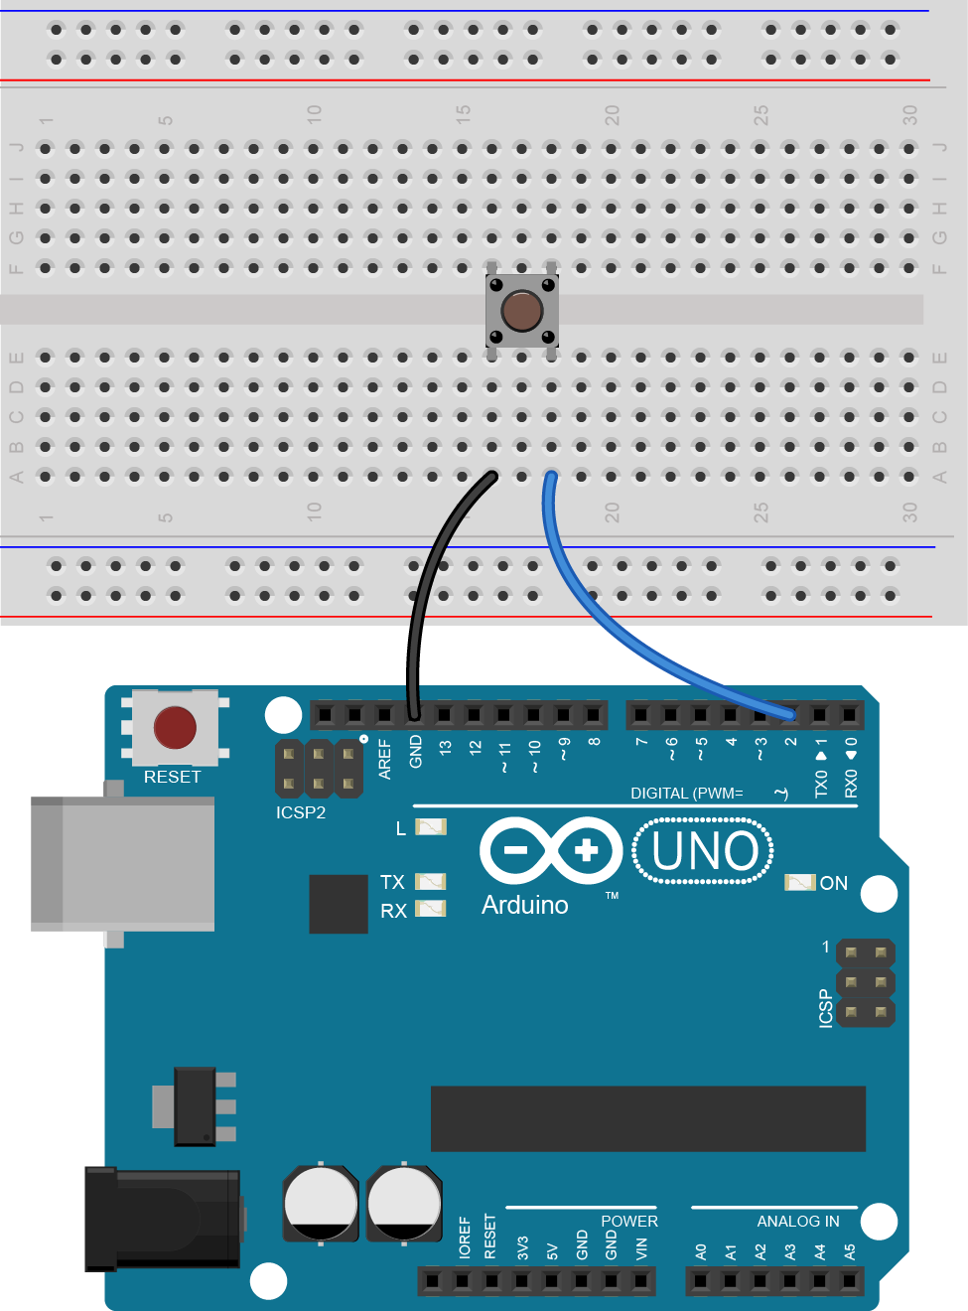
Digital Input
int buttonPin = 2;
int ledPin = 13;
void setup()
{
pinMode(buttonPin, INPUT_PULLUP);
pinMode(ledPin, OUTPUT);
}
void loop()
{
int buttonState = digitalRead(buttonPin);
digitalWrite(ledPin, buttonState);
}
Notes:
Points of interest:
Pull up resistor
digitalRead

Slide 8
Digital Input
int buttonPin = 2; // the number of the pushbutton pin
int ledPin = 13; // the number of the LED pin
int ledState = HIGH; // the current state of the output pin
int buttonState; // the current reading from the input pin
void setup() {
pinMode(buttonPin, INPUT_PULLUP);
pinMode(ledPin, OUTPUT);
}
void loop() {
int reading = digitalRead(buttonPin);
// if the button state has changed:
if (reading != buttonState) {
buttonState = reading;
// only toggle the LED if the new button state is LOW
if (buttonState == LOW) {
ledState = !ledState;
}
}
digitalWrite(ledPin, ledState); // set the LED
}
Notes:
Points of interest:
!= means not equal too
!ledState = ! ledState means toggle

Slide 9

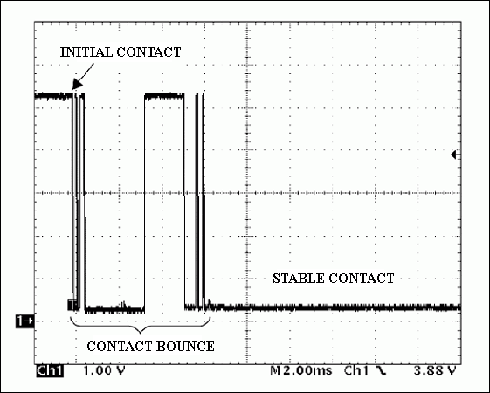
Button Bounce
You may have noticed an issue with the last circuit/code where the led would trigger multiple times with one press.
Unfortunately we don’t live in the ideal world. When you press the button it actually bounces a bit before making proper contact.
This can be solved in either software or hardware. Depending on your situation each has its merits

Slide 10
Software Debounce
int buttonPin = 2; // the number of the pushbutton pin
int ledPin = 13; // the number of the LED pin
int ledState = HIGH; // the current state of the output pin
int buttonState; // the current reading from the input pin
int lastButtonState = LOW; // the previous reading from the input pin
long lastDebounceTime = 0; // the last time the output pin was toggled
long debounceDelay = 50; // the debounce time; increase if the output flickers
void setup() {
pinMode(buttonPin, INPUT_PULLUP);
pinMode(ledPin, OUTPUT);
}
void loop() {
int reading = digitalRead(buttonPin);
// If the switch changed, due to noise or pressing
if (reading != lastButtonState) {
lastDebounceTime = millis(); // reset the debouncing timer
}
if ((millis() - lastDebounceTime) > debounceDelay) {
// whatever the reading is at, it's been there for longer
// than the debounce delay, so take it as the actual current state
// if the button state has changed
if (reading != buttonState) {
buttonState = reading;
// only toggle the LED if the new button state is LOW
if (buttonState == LOW)
ledState = !ledState;
}
}
}
digitalWrite(ledPin, ledState); // set the LED
lastButtonState = reading; // save the reading
}
Notes:
Points of interest
Millis = millisconds that the Arduino has been turned on

Slide 11
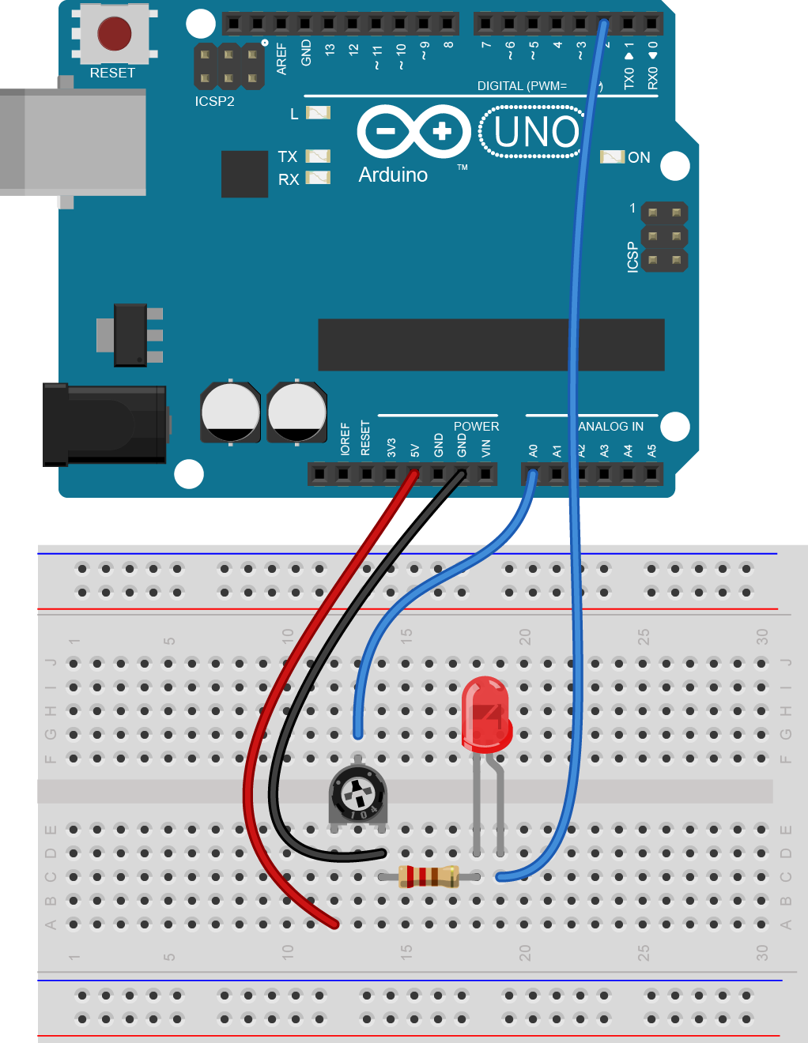
Analogue Input
void setup() {
//These are not the droids you are looking for
}
int potentiometerPin = A0;
void loop() {
int potentiometerVal = analogRead(potentiometerPin);
int outputVal = map(potentiometerVal, 0, 1024, 0, 255);
analogWrite(10, outputVal);
}

Slide 12

Final Challenges
Make a button toggle between a buzzer output and a LED output
Make the RGB LED fade colours based on the potentiometer
(Don’t spend too long on this one, the next one is more fun)
Make a “safe” using the potentiometer to enter the combination and press a button to unlock. Have a green and red LED to display whether the safe is locked or unlocked. If the wrong combination is entered 3 times an alarm should sound.

